Slide 1
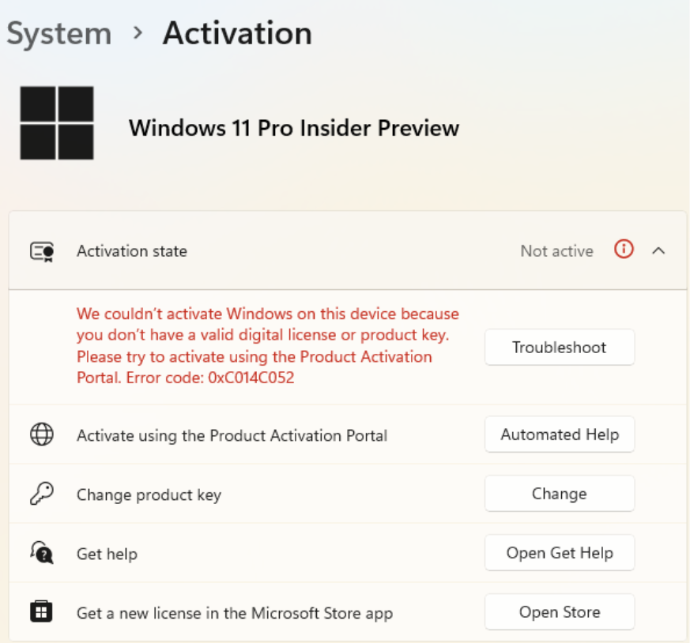
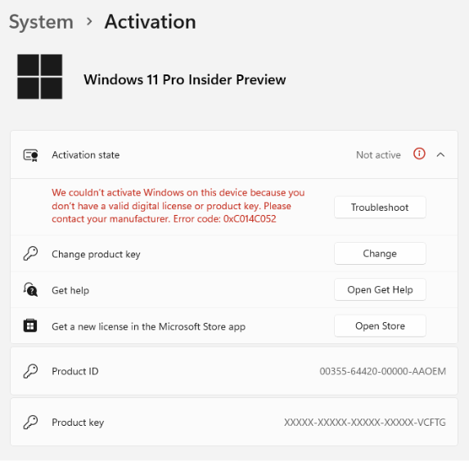
Phase 1 – Activation Experience
Modern OA - Setting Experience
Update: Product activation for Windows – online & support telephone numbers - Microsoft Support
Notes:
Update: Product activation for Windows – online & support telephone numbers - Microsoft Support

Slide 2
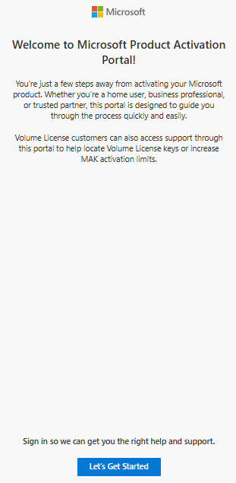
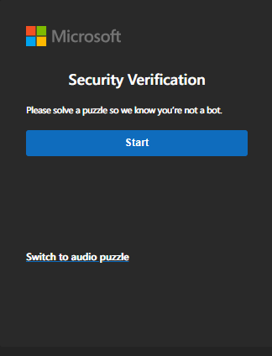
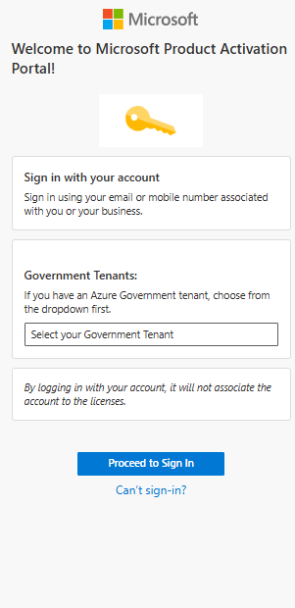
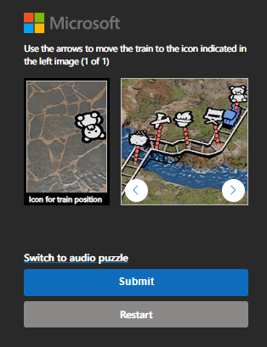
Microsoft Support | User Experience | Product Activation Portal
Let’s Get Started | Security Verification (Captcha) | Sign-In (MSA, Entra ID, & GOV Accounts)

Slide 3
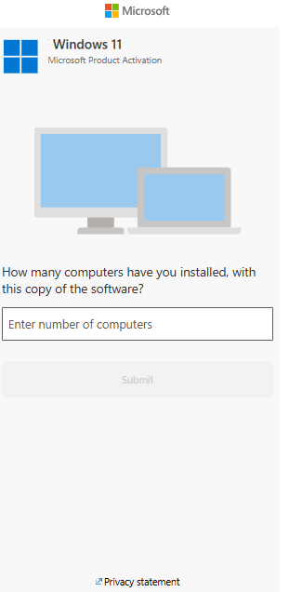
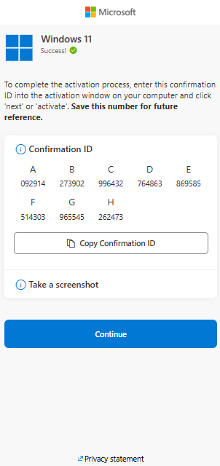
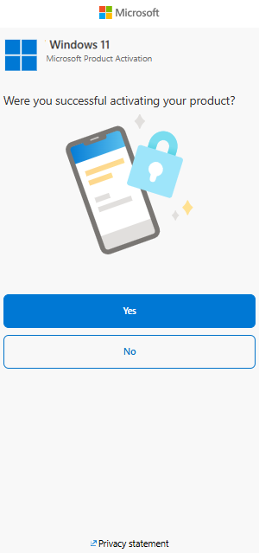
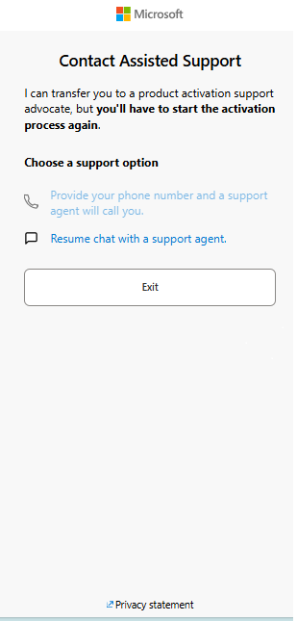
Microsoft Support | User Experience | Product Activation Portal
Answer # of Computers Question | Receive Confirmation ID (within threshold) | Confirm if Activation Succeeded or Failed | Choose Phone or Chat to Reach Live Support (if activation failed only)
Notes:
Thresholds- # of computers question:
If greater than 1, outside of threshold
If equal to or less than 1, within threshold

